Slide 1
8.7 Software Engineering
1-<number>

Slide 2
Specification
Determine system requirements
Understand constraints
Determine feasibility
End products
  High-level statement of requirements
  Mock-up of user interface
  Low-level requirements statement
1-<number>

Slide 3
Development
Create high-level design
Discover and resolve mistakes, omissions in specification
CASE tools to support design process
Object-oriented systems have advantages
After detailed design, actual programs written
Result: working software system
1-<number>

Slide 4
Validation (Testing)
Ensure software satisfies specification
Ensure software meets user’s needs
Challenges to testing software
  Noncontinuous responses to changes in input
  Exhaustive testing impossible
  Testing reveals bugs, but cannot prove none exist
Test modules, then subsystems, then system
1-<number>

Slide 5
Software Quality Is Improving
Standish Group tracks IT projects
Situation in 1994
  1/3 projects cancelled before completion
  1/2 projects had time and/or cost overruns
  1/6 projects completed on time and on budget
Situation in 2009
  1/4 projects cancelled
  5/12 projects had time and/or cost overruns
  1/3 projects completed on time and on budget
1-<number>

Slide 6
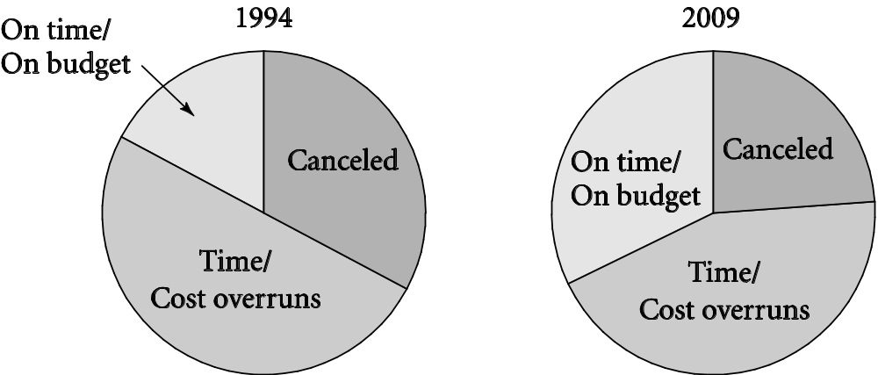
Success of IT Projects Over Time
1-<number>

Slide 7
8.8 Software Warranties and
Vendor Liability
1-<number>

Slide 8
Shrinkwrap Warranties
Some say you accept software “as is”
Some offer 90-day replacement or money-back guarantee
None accept liability for harm caused by use of software
1-<number>

Slide 9
Are Software Warranties Enforceable?
Mass-marketed software and software included in sale of hardware likely to be considered a good by a court of law
Uniform Commercial Code applies to goods, despite what warranties may say
1-<number>

Slide 10
Key Court Cases
Step-Saver Data Systems v. Wyse Technology and the Software Link
  Court ruled that provisions of UCC held
ProCD v. Zeidenberg
  Court ruled shrinkwrap licenses are enforceable
Mortenson v. Timberline Software
  Court ruled in favor of Timberline and licensing agreement that limited consequential damages
1-<number>

Slide 11
Moral Responsibility of Software Manufacturers
If vendors were responsible for harmful consequences of defects
  Companies would test software more
  They would have to purchase liability insurance
  Software would cost more
  Start-ups would be affected more than big companies
  Less innovation in software industry?
  Software would be more reliable?
Making vendors responsible for harmful consequences of defects may be a bad idea, but…
Consumers should not have to pay for bug fixes
1-<number>

